Slide 2
Teacher’s Identity
Mst.Dulali Fatema
Assistant Teacher(English)
Rustom Ali High School,Roghunathpur
Kaligonj,Jhenidah.

Slide 3
Lesson Identity
Class:Nine
Subject:English First Paper
Unit: 3
Leson:3
Time :50minute
Date:22-12-15

Slide 4
Learning outcomes
After studied this lesson, we will be able to
know about the history of independence
know some vocabulary
answer the question

Slide 5
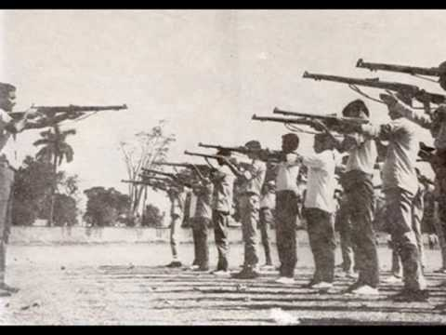
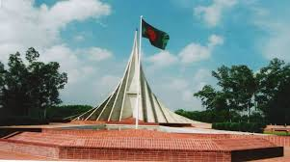
What do you see in the pictures ?
Is there any relation btween the two picturs?

Slide 6
Independence Day

Slide 7
Let’s enjoy a video

Slide 9
Before reading the text I will discuss with you some vocabulary

Slide 10
Floral wreaths
Noun
Arrangement of flowers
Enthusiasm
Noun
Strong desire
Noun
Spectator
Viewer

Slide 11
Open at page 41
4
Read the text in section B carefully and fill in the gaps

Slide 12
Have you finished reading?

Slide 13
Now try to fill in the following gapes.

Slide 14
month
1971
achieved
independent
26 March
victory
Bangladesh is an ---------------- country . She has got indepndence in--------.
--------- is our independence day. She has ---------idependence after a bloody battle of nine ----------.16December is our -------- day.

Slide 15
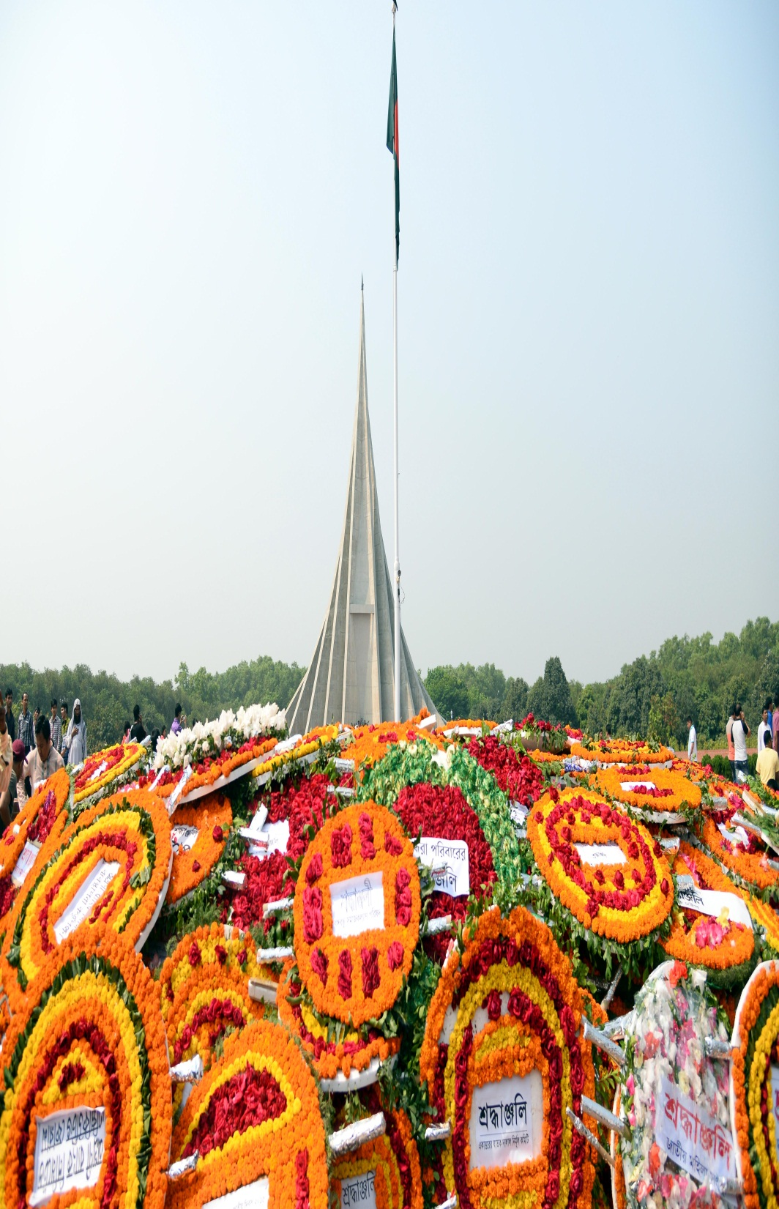
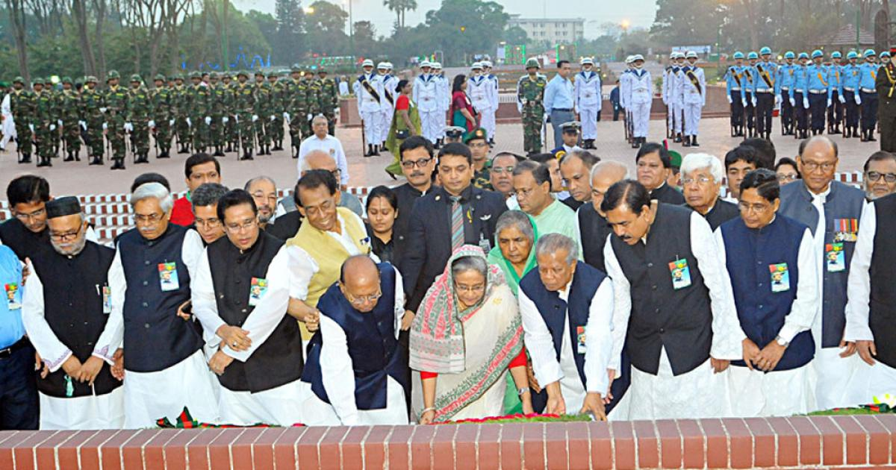
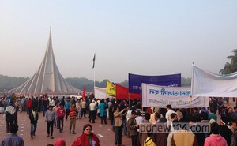

Slide 16
Group work
a)How and when do we start our independence day ? b)Who pay homage to the martyrs?
c)Who hold cultural functions on this day?

Slide 17
a)We start the day in the morning with 31 gunshots.
b)The President ,the Prime Minister, diplomats, political parties social and cultural oganisations and freedom fighters pay homage to the martyrs .
c)Bangla Academy, Bangladesh Shilpakala Academy and other socio-cultural organisations hold cultural functions.

Slide 18
Evaluation
Complete the sentences
National memorial is at -------
The country witness a smartly-----------
National flag is hoisted on-----------------
savar.
dressed parade.
the top of important buildings

Slide 19
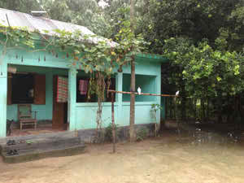
Home work
Write a paragraph on
Independence Day

Slide 20
